Slide 1
Physiological Assessment of Coronary Artery Disease
Sreejith V

Slide 2
Main things to discuss..
Intracoronary flow measurement
Intracoronary Pressure measurement
Combined

Slide 3
Structure & Function of the Coronary circulation
Epicardial arteries (>400 μm in diameter)
  Serve a conduit artery function,
Coronary resistance
  Resistance arteries (100 to 400 μm),
  Arterioles (>100 μm),.
Capillary density
  Average intercapillary distance of 17 μ m

Slide 4
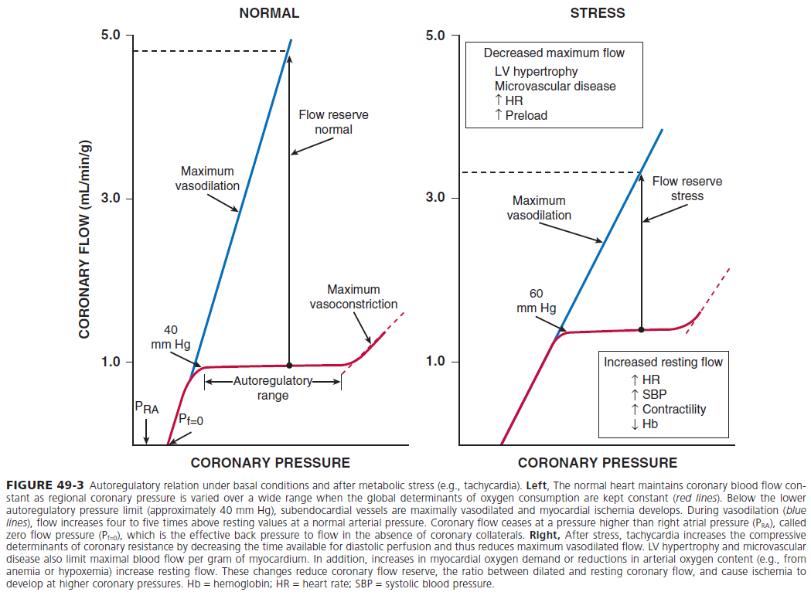
The Coronary blood flow
Oxygen extraction at rest is around 70 %
Increase in oxygen demand
  Is met by increase in coronary blood flow
  Dilation of microcirculation
Coronary blood flow
  At rest is 250ml/min
  Stress upto 5 times

Slide 5
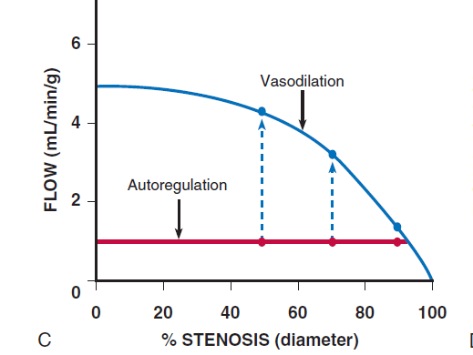
Myocardial ischemia results from…
  Microcirculation dysfunction
  Epicardial stenosis >50
  Coronary angiography
  Fails to detect perfectly 70 %

Slide 6
Limitations of coronary angiography
Interpretation is highly subjective
Intermediately severe luminal narrowing (40% -70%) cannot be accurately determined
Identification of normal and diseased vessel segments is complicated by diffuse disease
Artifacts of contrast streaming
Image foreshortening
Overlapping vessels

Slide 7
Flow Velocity
The flow velocity of red blood cells moving past theultrasound emitter/receiver on the end of a guidewire
The cross-sectional area of a 0.014-inch– (0.356-mm)– diameter sensor guidewire is 0.099 mm2, only 1.4% of the cross-sectional area of a 3-mm–diameter vessel and approximately 12% of the lumen area in a vessel with a diameter of 1 mm.
The error contributed by the measurement wire in this system favors overestimating severity in the marginal cases over missing hemodynamically significant lesions.

Slide 8
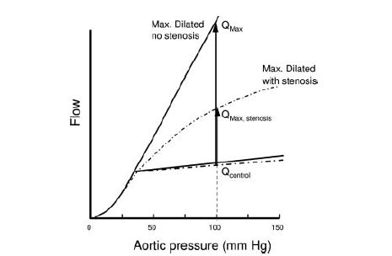
Coronary flow reserve

Slide 9
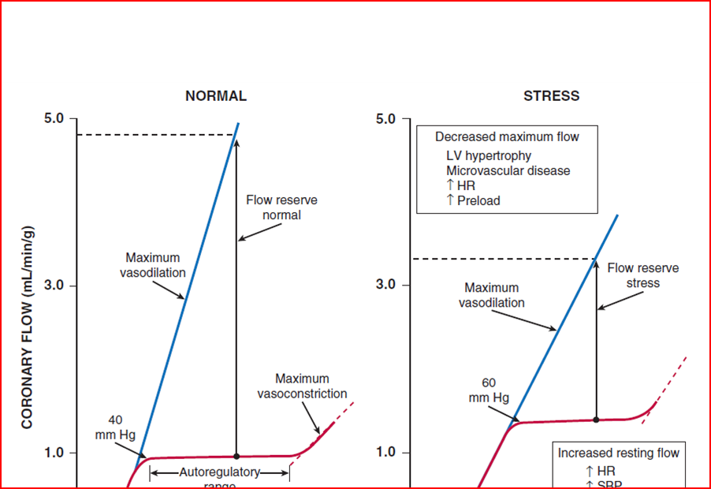
Coronary flow reserve
Normal CFR
  Early studies 3.5 to 5
  CAD Risk factors 2.70
Abnormal CFR
  Microvascular disease.
  Epicardial
ischemic threshold <2.0.

Slide 10
rCFR
Ratio
  maximal flow in a coronary artery with stenosis (QS) to
  maximal flow in a normal coronary artery without a stenosis
Normal range 0.8 to 1.0
Limited role in MVD
Assumes that the microvascular circulatory response is uniformly distributed among the myocardial beds
Is of no value
  In with myocardial infarction
  left ventricular regional dysfunction
  Asymmetric hypertrophy

Slide 11
Collateral Circulation
Collateral flow can be quantified by Doppler.
Collateral flow is displayed on the monitor by shading below the 0 line, indicating blood flow towards the wire tip rather than away from it,
This is most useful when assessing flow within graft recipient vessels to assess graft and primary lesion patency.

Slide 12
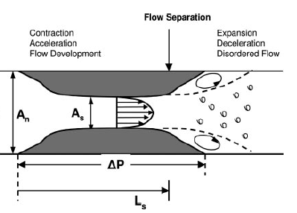
Coronary Pressure
The resistance to flow through a stenosis caused by viscous friction, flow separation, turbulence, and eddies at the site of the stenosis results in energy loss.
Energy loss produces pressure loss distal to the stenosis and thus a pressure gradient across the narrowed segment

Slide 13
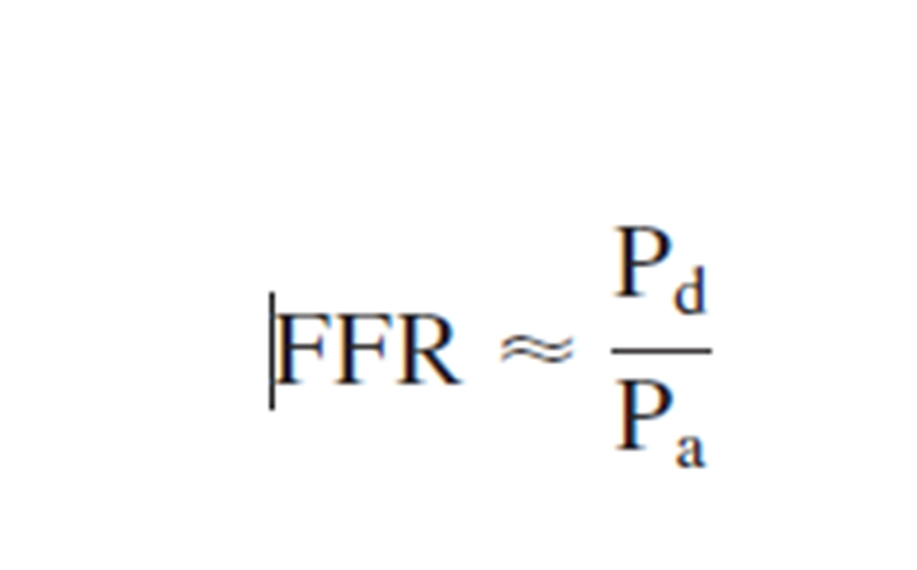
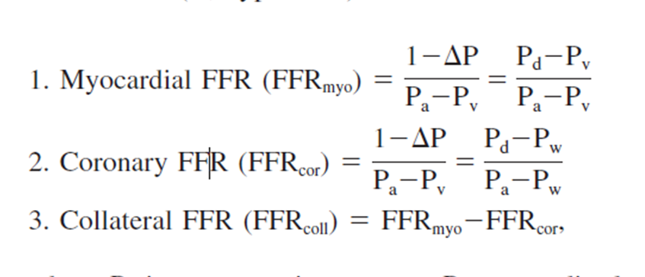
Fractional Flow Reserve
Ratio of the coronary pressure measured distal to the stenosis to aortic pressure after maximal hyperemia

Slide 14
FFR
Normal value 1
An FFR value of 0.6 means the maximum myocardial flow across the stenosis is only 60% of what it should be without the stenosis
An FFR <0.75 is associated with inducible ischemia (specificity, 100%),
An FFR a value >0.80 indicates absence of inducible ischemia in the majority of patients (sensitivity, 90%).

Slide 16
FFR - advantages
Human studies did not show significant changes in FFR with changes in
  heart rate,
  blood pressure,
  contractility.
FFR has a high reproducibility
Low intra-individual variability
FFR, unlike CFR, is independent of
  gender and
  CAD risk factors
It varies less with common doses of adenosine than does CFR

Slide 17
FFR- TECHNIQUE
Catheter
Diagnostic catheters can not be used to measure FFR - pressure measurements can be inaccurate & the wire manipulation is met with friction due to smaller internal diameters compared to guide catheters.
The main advantage of using guide catheters is that PCI is immediately possible if required.
Guide catheter with Side holes should not be used
  It can create a false gradient between the side holes & the tip of the guide catheter creating a false Positive FFR.
  Pharmacological vasodilatory agents may be flushed into the aorta instead of the coronary artery.

Slide 18
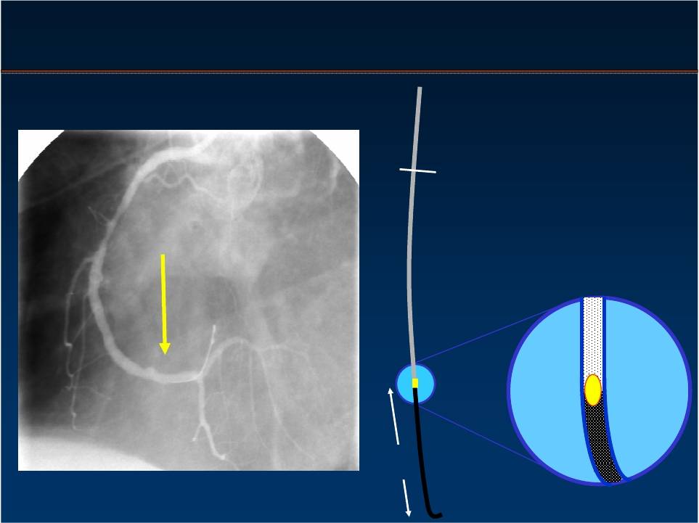
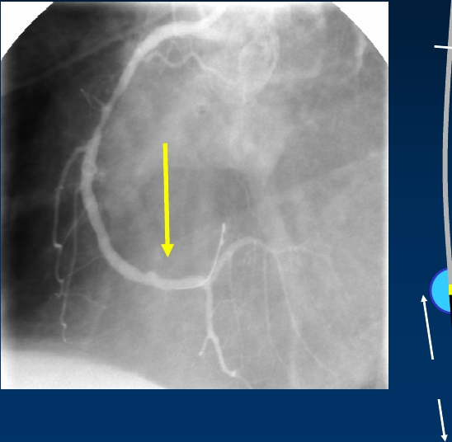

Pressure Monitoring Guide Wire
0.014”
3 cm

Slide 19
Pressure Measurement
Step 1: Zero the Pressure System to the Atmosphere
Step 2: Insert the Pressure Sensor Guide Wire Into the Guide and Equalize the 2 Pressures
Step 3: Advance the Pressure Wire Sensor Distal to the Region of Interest
Step 4: Induce Maximal Hyperemia
Step 5: Wire Pullback to Check for Signal Drift
Notes:
A standard fluid-filled pressure transducer is used for aortic pressure recordings.
Special attention should be paid to purging the system of air, zeroing of the catheter tubing system, and obtaining an optimal aortic pressure waveform.
The guiding catheter should be frequently flushed with normal saline (at least every 10 minutes). Because contrast medium may subtly dampen the catheter pressure waveform, all contrast medium should be flushed from the catheter during the zeroing steps before pressure measurement.
If any pressure damping or ventricularization of the catheter pressure waveform is observed, the guiding catheter should be gently disengaged from the ostium, taking care not to alter the position of the pressure wire in the distal vessel.
Zero the sensor of the pressure wire ex vivo, following the instructions of the manufacturer.

Slide 20
Maximal Hyperaemia
Epicardial & resistance arteries have to be vasodilated.
Epicardial vessels are dilated using a bolus of 100-200 mcg of intracoronary nitroglycerine at least 30 seconds before the first measurement.
Hyperaemia is induced in the resistance vessels using adenosine ( IC or IV ) or papaverine ( IC )
Notes:
Hyperemia is essential for stenosis assessment. Maximal vasodilatation of the 2 compartments of the coronary circulation (epicardial or “conductance arteries >400 μm” and the microvasculature or “resistance arteries”) is required for accurate and reproducible measurements.
To abolish epicardial vasoconstrictor tone, an intracoronary bolus of 2 mg of isosorbide dinitrate or an equivalent dose of another nitrate such as nitroglycerin (200 μg) should be administered at least 2 minutes before FFR measurement. To obtain maximum microvascular vasodilation and eliminate coronary autoregulation, a continuous infusion of adenosine through a large-bore cannula, in a large vein, at a rate of 140 μg/kg per minute, is recommended. It provides steady-state maximum hyperemia within 2 minutes. Continuous adenosine infusion is advocated because it allows for FFR measurement in specific settings (ie, at aorta-coronary ostial lesions) and permits recording of a pressure pullback curve to differentiate focal from diffuse coronary artery disease. The injection of additional intracoronary boluses of adenosine, in an attempt to stimulate maximal hyperemia, is discouraged because it may provoke artifacts in the FFR tracing due to the injection that complicate off-line analysis. Similarly, other vasodilators such as papaverine and sodium nitroprusside, administered as boluses, are not advocated due to the transient steady state achieved.
Maximum vasodilatation is essential part of measurement of FFR.

Slide 21
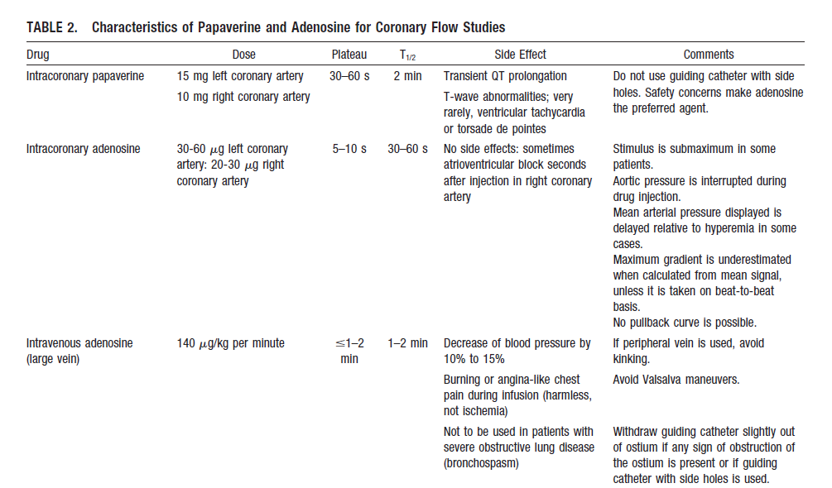
Notes:
Weight X 8.4 flow rate, 480 ml/hr /60 X3

Slide 22
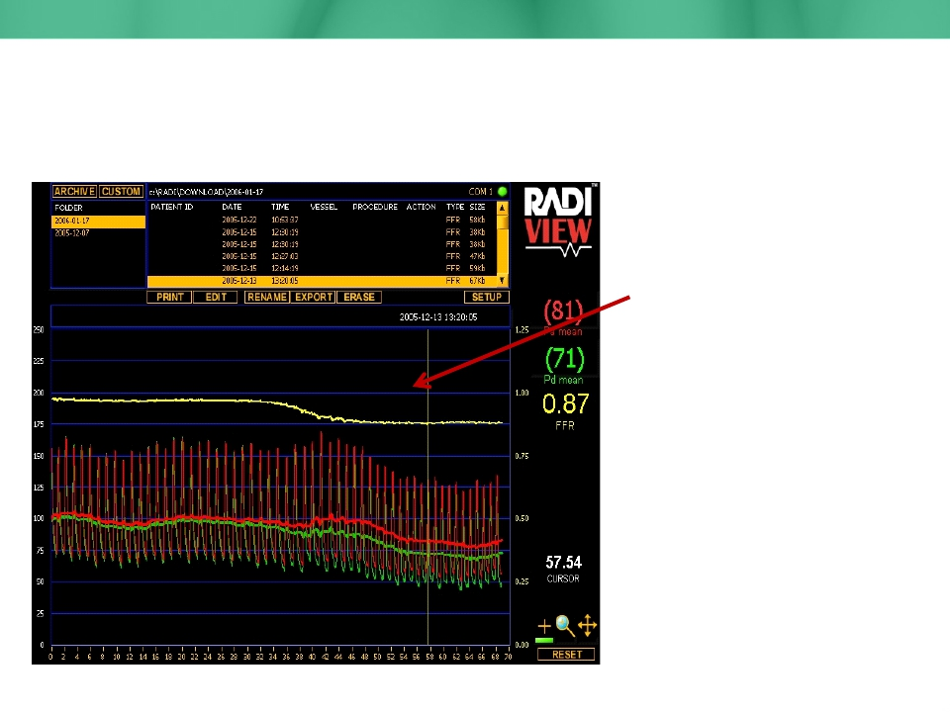
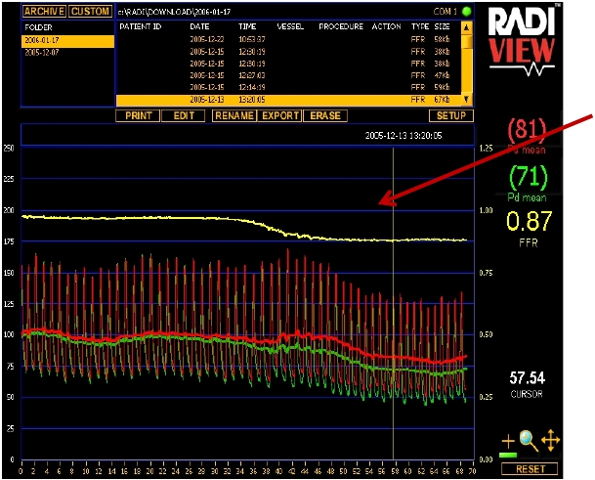
Maximum Hyperemia
Horizontal Pd/Pa line:
Steady State and likely
Maximum Hyperemia

Slide 23
Adenosine
From ATP
Angina
CI in asthma
Dilute 6 mg in 250 mL bag of D5W, - of 24 µg/mL.
ATP, also used

Slide 24
Safety of Intracoronary Sensor-Wire Measurements
Transient bradycardia (1.7%),
Coronary spasm (2%),
Ventricular fibrillation (0.2%).
Qian J, Ge J, Baumgart D, Oldenburg O, Haude M, Sack S, Erbel R. Safety of intracoronary Doppler flow measurement. Am Heart J. 2000; 140:502–510

Slide 25
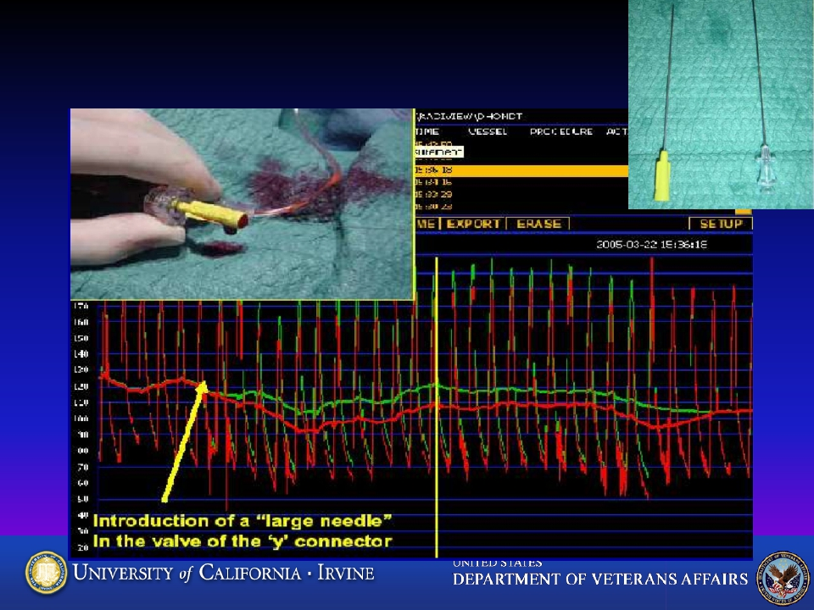
Effect of Wire Introducer

Slide 26
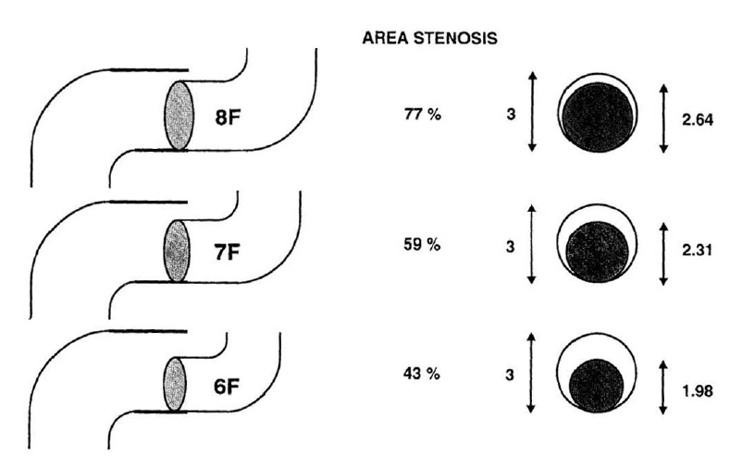
Impact of Catheter Size on Hyperemic Flow
De Bruyne, et al. Cathet Cardiovasc Diagn 1994;33:145-152.

Slide 27
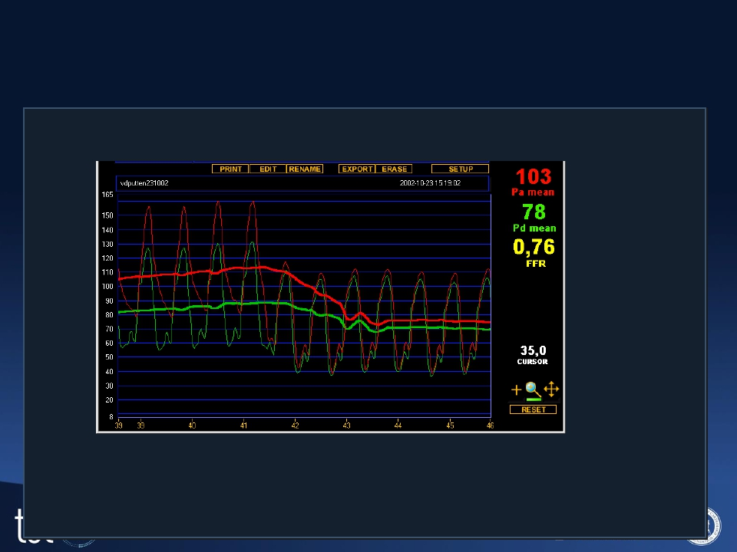
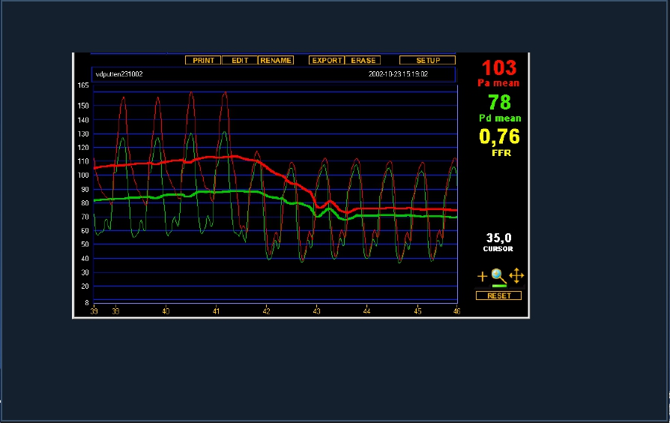
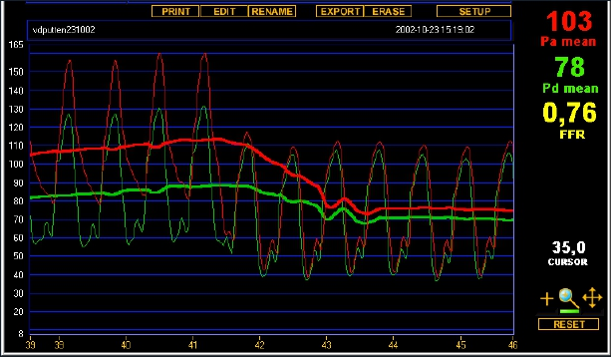
Guiding catheter related
• Small ostium, too large guiding catheter
guiding in ostium
guiding out ostium
• Solve by dislodging guiding and using iv adenosine

Slide 28
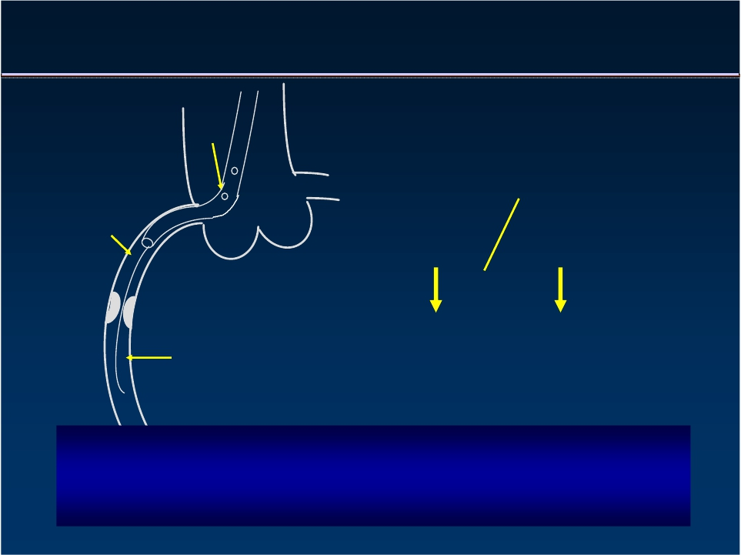

FFR and Guidings with Side-Holes
Pa
Pc
Pc
=
Pa
Pressure recorded by guiding
Pd
When wedging of the catheter, withdraw guiding from ostium
For flow or pressure measurements:
NO SIDE-HOLES

Slide 29
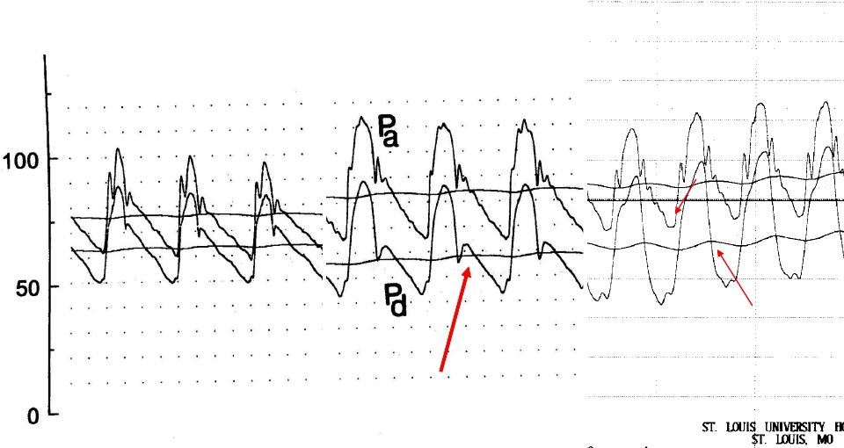
Drift
Drift
True Gradient
Notch
Notch
No notch
Notch

Slide 30
FFR IN DIFFERENT CLINICAL SCENARIO

Slide 31
Relation between FFR & viable myocardium :
  If a stenotic vessel supplies a larger viable myocardial mass, there will be larger hyperaemic flow during maximal vasodilation resulting in a greater gradient between Pd & Pa & thus , a lower value of FFR.
  Therefore , the haemodynamic significance of a lesion is dependent on its perfusion territory.

Slide 32
Multivessel disease
FAME study: Study Population
Inclusion criteria:
ALL patients with multivessel disease
At least 2 stenoses ≥ 50% in 2 or 3 major epicardial
coronary artery disease, amenable for stenting
Exclusion criteria:
Left main disease or previous bypass surgery
ST-elevation MI with CK > 1000 U/l within last 5 days
extremely tortuous or calcified coronary arteries
Note: patients with previous PCI were not excluded

Slide 33
CONCLUSIONS:
Routine measurement of FFR in patients with multivessel disease (MVD) who are undergoing PCI with drug-eluting stents (DES) significantly improves outcomes at 1 year by reducing MACE (composite rate of death, nonfatal myocardial infarction, and repeat revascularization)

Slide 34
Left Main and Ostial Lesions
Angiography cannot reliably characterize many ostial lesions,
In multivessel disease, uncertainty about the contribution of the LMCA to the clinical syndrome may confuse the issue of whether to perform PCI or surgery.
FFR measurements should be performed with the guiding catheter disengaged from the coronary ostium and with hyperemia induced by intravenous adenosine

Slide 36
Intermediate lesions
The DEFER study has shown that patients with single vessel stenosis and FFR >0.75 who did not undergo PCI had excellent outcomes.
The risk of cardiac death or MI related to the stenosis was < 1% per year and was not reduced with PCI.
In contrast, patients with single-vessel stenosis and FFR <0.75 are 5× more likely to experience cardiac death or MI within 5 years, despite undergoing revascularization.

Slide 37
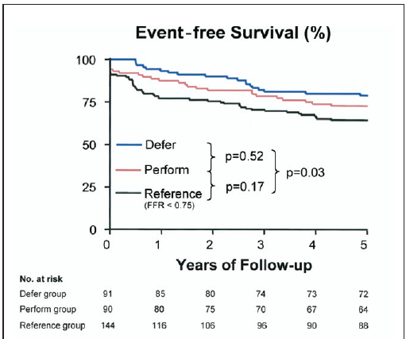

Slide 38
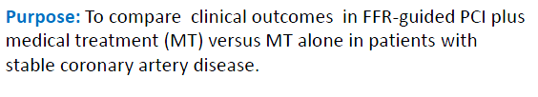
FAME II: Stable Coronary Artery Disease

Slide 39

FAME 2: Primary Outcomes
FFR-Guided PCI
(n=447)
4.3%
0.2%
3.4%
1.6%
89%
MT
(n=441)
12.7%
0.7%
3.2%
11.1%
71%
P-Value
<0.001
0.31
0.89
<0.001
<0.001
Primary Endpoint
Death
Myocardial Infarction
Urgent Revascularization
Free from Angina (1 month)
De Bruyne B,et al. N Engl J Med. 2012 Sep 13;367(11):991-1001.

Slide 40
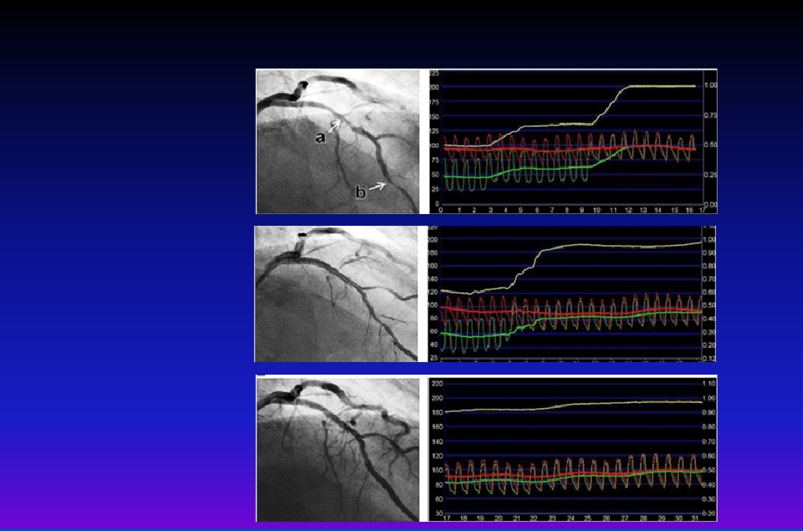
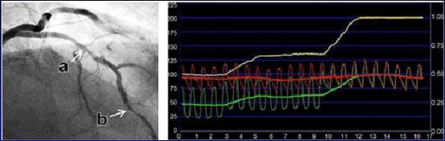
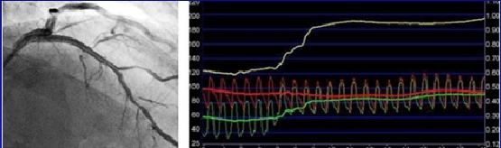
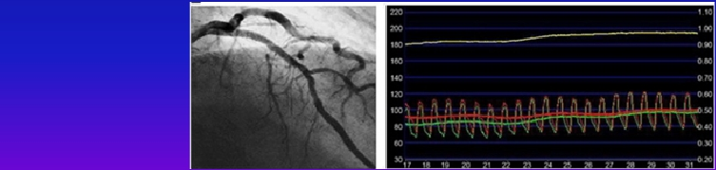
Considerations for Serial lesions
Pre FFR (1+2) with
pullback
Lesion 1 large dP,
Stent
Recheck FFR
Treat lesion 2,
Final FFR
J Am Coll Cardiol Intv.
2012;5(10):1013-1018.

Slide 41

FFR Guided PCI of Serial Lesions
N=131 Patients with multiple 40-70% stenoses, 2 centers
N=298 Lesions, at least 20 mm apart, either chronic CAD or no
• Lesion with largest pressure drop was
stented first (116 total stents, 70 proximal,
46 distal)
• Strategy not clearly stated but seems like
goal was to achieve post stent FFR > 0.80
• Revascularization deferred in 61% lesions
• ≥2 stents deployed in only 18% vessels
Kim et al. J Am Coll Cardiol Intv 2012;5:1013-8

Slide 42
Calculation of the exact FFR of each lesion
The calculation of the exact FFR of each lesion separately is possible
Coronary wedge pressure is needed
Remains academic
the pressure pullback recording is normally used

Slide 43
Diffuse Disease and Long Lesions
The location of a focal pressure drop superimposed on the diffuse disease can be identified as an appropriate location for treatment.
  PCI
In some cases, the gradual decline of pressure along the vessel occurs over a very long segment, such that interventional treatment is not possible.
  Medical treatment (or bypass surgery)

Slide 45
Microvascular disease
Endothelial dysfunction is associated with inducible ischemia
Endothelial dysfunction is an early stage of atherosclerosis and is associated with poor prognosis
Microvascular disease can be detected in stenosis-free vessels through the use of CFR.
If a bolus of adenosine is given in a stenosis-free vessel and the resulting increase in blood flow is less than two times what it was before the injection

Slide 46
Microvascular disease
Response to graded intracoronary infusions of acetylcholine.
In coronary arteries with normal endothelium, intracoronary acetylcholine dilates epicardial and microvascular circulation, increasing coronary blood flow.
When the endothelium is damaged or disrupted, intracoronary acetylcholine induces vasoconstriction and a decrease in coronary blood flow.

Slide 47
CABG conduit patency
20-25 % of grafts done to physiologically nonsignificant lesions ( FFR > 0.80) were found to be occluded at 1 yr.
This occurs because blood flow favors a path of lower resistance through the native vessel with a nonsignificant obstruction as compared to a vein graft.
Thus FFR can provide information about future graft patency & allows an appropriate selection of the vessel which should not be grafted
FFR can be used to determine the physiological significance of a lesion in a graft vessel.
Notes:
Prediction of Coronary Artery Bypass Graft Conduit Patency
Bypass grafting of nonfunctional coronary stenosis is believed to enhance the graft closure, as the blood flow favors the lower-resistance path in the native vessel rather than the vein graft with slower flow.50
In a study that included 450 grafts with preoperative FFR >0.80 in the native vessel, the incidence of graft occlusion was 20% to 25%.51
Although the patients with occluded or patent grafts on the nonsignificant coronary lesion did not yet experience increased rates of angina or revascularization, the study points out that FFR has prognostic implications for graft patency in patients with multivessel CAD planned for CABG.

Slide 48
Combined Pressure and Flow Measurements
Hyperemic stenosis resistance (HSR) index
P/v, P = hyperemic pressure gradient v = average peak velocity
A refined physiological measurement quantifying the impediment to maximal flow caused exclusively by the stenosis
Normal reference value ZERO and is independent of basal hemodynamic factors.
Value > 0.8 mm Hg/cm per s. is the threshold for prediction of reversible ischemia when compared with noninvasive stress testing

Slide 49
Economics of Physiologically
Guided Interventions
The investigators found that the FFR strategy saved $1795 per patient as compared with the NUC strategy and $3830 per patient as compared with the STENT strategy.

Slide 50


Slide 51
QUESTIONS

Slide 52
FAME II TRIAL STUDIED WHICH GROUP OF CAD?

Slide 53
WHAT IS THE DOSE OF IV ADENOSINE FOR FFR

Slide 54
NORMAL HSR VALUE

Slide 55
WHICH CATHETRE IS BEST FOR FFR

Slide 56
WHAT IS THE COST OF FFR WIRE

Slide 57
CFR ISCHEMIC CUT OFF?

